Slide 1


Enron Europe
Trading - FX & IR BRM
DRAFT - For discussion purposes only

Slide 2
Contents
Scope & approach
Key issues and recommendations
Phase 1 Trading book exposures
  Overview
  Trading FX / IR exposures
Phase 2 - FX and IR management
Phase 3 - Rates and conversions

Slide 3
Scope
Phase 1: Business Reality
  Understand underlying FX / IR exposures & risk management approach for the following desks:
    Continental Power
    Continental Gas
    Global Liquids (including J Block, Petrochemicals and Cremona)
    Coal
  Identify foreign exchange risk management policy and form and extent of communication of policy

Slide 4
Scope
Phase 2: FX Desk Activities & FX / IR Settlement Activities
  High level understanding of FX / IR dealing process
  Exposure monitoring & reporting
  High level understanding of FX / IR settlement procedures
  Identify opportunities to improve efficiencies & effectiveness

Slide 5
Scope
Phase 3: Conversion & FX Rates
  Understand the processing & conversion cycle from deal capture to the general ledger
    Continental Power - followed tradeflow for a CHF denominated deal
    Continental Gas - followed tradeflow for a EUR denominated deal
    Global Liquids - followed tradeflow for a Petrochemical Platts deal
    Coal - followed tradeflow for a GBP sell deal
  Identify when, where & by whom FX rates are input into information systems
  Identify & evaluate controls surrounding application of FX rates

Slide 6
Key Messages
  Up until now foreign exchange risk has been judged not to be a significant issue for Enron. This was primarily because most business was conducted in North America. With the expansion into Europe and continuing growth of the European operations the quantification and management of foreign exchange risk is becoming a more significant issue. Business process and technology reflect the North American focus of the business, resulting in foreign exchange transaction exposure not being quantified or visible above the commodity desk level.
  It is common understanding within Enron Europe that commodity traders believe it is within their discretion whether to hedge or maintain a foreign exchange position. This contradicts Enron’s risk philosophy of factoring out risk to the appropriate risk desk. An appropriate foreign exchange policy would clarify management of foreign exchange risk and apportion accountability.

Slide 7
FX Exposure
Enron Europe’s currency exposure is complex not only because of its legal structure, but also because of the design of traders’ performance measures which are based on each commodity desk’s significant trading currency and span across the legal entity matrix
  Enron is exposed to a number of different types of foreign exchange exposures, each which can arise in a single commodity transaction. These are as follows:
    economic/inherent exposure
    transaction exposure (see A below)
    book to local currency exposure
    translation exposure arising on consolidation
    (refer following diagram for examples of the above exposures)
  Local/functional currencies within Enron Europe are generally EUR, GBP or USD denominated. Enron Europe has a complex legal entity structure with 130+ separate entities
  The book currency is the currency in which the commodity traders’ performance is measured and hence it is this currency to which he/she manages FX exposures.
  (A) In common treasury language, transaction exposure represents the risk of a change in exchange rates between the functional currency and the currency in which a transaction is denominated. At Enron the term transaction exposure is taken to be the risk of a change due to the transaction denominated in a currency different to that of the book reporting currency. This is because commodity desks hedge to a currency which can be different from that of the local/ functional currency. Therefore for the purposes of this report, transaction exposure has been split into two elements: transaction currency exposure and book to local currency exposure

Slide 8
FX Exposure
Enron Group’s functional currency is USD but Enron Europe does not have a defined framework for managing its foreign exchange exposures.
This impacts:
  To which currency(s) Enron Europe should be managing its cash position
  Whether or not Enron Europe should be managing its profit translation exposure by way of hedging to achieve the USD denominated budget
  The management of foreign exchange transaction exposure by commodity desks (both percentage hedged and duration)
  Whether or not Enron Europe should be managing the book to local currency exposure
  Whether or not Enron Europe should be quantifying and reporting exposures at a consolidated level
  Additionally, with USD being the Group’s functional currency, the SAP system was set up as a dollar based system with intercompany balances translated to USD directly from transaction currency (instead of local currency). This has resulted in a $1.9m overstatement of Europe’s current results when reported in USD. This practice is inconsistent with FAS 52 although it may not be material at a Group level

Slide 9
FX Exposure
Transaction Currency
Book Currency
Local Currency
Group Currency
e.g.
Continental Power
Power-trade
CHF
EUR
Mainly GBP*
USD
Economic/ inherent exposure
Transaction exposure
Book to local currency exposure
Translation exposure arising on consolidation
e.g.
Continental Gas Rheinescheine
USD
EUR
GBP
Mainly GBP*
USD
Rheinescheine price is based on a USD index (EUR/USD hedged with FX desk)
Hedged, but not 100% by commodity trading desks
* trading desks sit across a number of legal entities

Slide 10
FX Exposure
Transaction Currency
Book Currency
Local Currency
Group Currency
Transaction exposure
Quantification of Enron Group’s FX exposures arising from Enron Europe:
Of the four trading desks reviewed in the BRM none hedge 100% of their transaction exposure. As at a point in time (August 2000) net unhedged transaction exposure for the four desks reviewed was:
  USD equivalent
  + EUR 4.3m 3.7m
- GBP 33m 46m (A)
+ CHF 31m 18m
+ DKK 24m 2m
+ ITL 4bn/mth 1.7m
+ DEM 1m/mth 400k
Any fluctuations in these currencies will have a direct impact on Enron Europe’s trading results
(A) This represents an overhedged position in the coal book - refer issue documented on management of Book Translation exposure

Slide 11
FX Exposure
Transaction Currency
Book Currency
Local Currency
Group Currency
Book to local
currency exposure
Unrealised profit and loss is booked into SAP in book currency and converted into local currency at the spot rate on the date of input (or value date)
There is currently no clear process to quantify and monitor the book to local currency exposure
This exposure would be reduced by aligning book and local currencies, however this may not be feasible

Slide 12
FX Exposure
Transaction Currency
Book Currency
Local Currency
Group Currency
Translation exposure of Enron Europe’s net income:
Total net income for Q1 was USD 29m profit
Upon translation of Q1 results into group currency, Enron Europe's net income was exposed to currency movements on:
  GBP 60m profit (USD 96m)
  NOK 33m profit (USD 4m)
  SEK 7m profit (USD 0.8m)
  EUR 3m loss (USD 3m)
  USD 69m loss
Hence Enron Europe’s USD Q1 results were significantly impacted by the GBP/USD exchange rate. This exposure represents the amount of GBP revenue in excess of GBP expenses
There is no clear process to quantify and monitor the potential impact of foreign exchange movements on USD budgeted results
Translation exposure arising on consolidation

Slide 13
Key Issues and Recommendations
Key Structural Issues:
Policy - FX transaction exposure
Policy - FX economic/inherent exposure
Policy - book to local currency exposure
Policy - Translation exposure arising on consolidation
Management Reports
Cash Management
Significant Compliance Issues:
Transaction exposure - Hedge duration
Transaction exposure - Hedge amount
Settlement and book revaluation exposure
Standardised FX procedures
Systems - TAGG
Systems - SAP
Systems - SAP translation currency difference

Slide 14
Key Issues and Recommendations
Policy - FX transaction
Enron Corporation has a formal FX policy document (dated 1 February 1999) which states that “foreign exchange exposure related to the commodity trading assets and liabilities (i.e. assets/liabilities that are carried in the price risk management section of the balance sheet) is to be fully hedged with ECT, where possible.” Trading desks are not aware of this policy document and instead believe there is an implicit policy that the trading desk has the choice of whether to manage the FX transaction risk.

Slide 15
Key Issues and Recommendations
Policy - FX transaction continued
Recommendation:
Enron’s FX policy should be revisited, as it is not being enforced.
  The currency transaction exposure management policy should include:
  description of how the risks arise
  objectives of the policy
  indications of the materiality of the risk (direction should be given from Enron Corporation)
  who is responsible for hedging the exposure
  limits and targets for hedging the exposure with a clear statement of the ability to deviate from target if relevant
  a list of authorised hedging instruments and strategies (if required)
  list of authorised counterparties (should be FX desk)
  reference table of authority limits
  performance measures e.g. trading desks are measured on book currency profit

Slide 16
Key Issues and Recommendations
Policy - FX economic/inherent exposure
Enron does not have a formal policy for managing foreign exchange economic/inherent exposure. An example of economic exposure is when a desk prices a trade based on an index denominated in another currency. For the Rheinescheine deal, the Continental Gas desk has a EUR denominated receipt based on the oil index (USD denominated). For a pictorial representation of this trade refer to the Continental Gas diagram on page 38. The Continental Gas desk hedged this exposure with the FX desk at the outset of the trade.

Slide 17
Key Issues and Recommendations
Policy - FX economic/inherent exposure continued
Another example is the Continental Power desk buying power in CHF with a view (in 2 years) to sell power to Germany in EUR. The economics of the decision to sell to Germany was dependent on the CHF/EUR spot rate over the next two years. There is a risk that the Board’s objective of single commodity risk management is inconsistent with Enron Europe’s current risk management practices. This exposure is currently hedged
Recommendation:
Policy needs to state who is responsible for managing this exposure and whether it should be hedged

Slide 18
Key Issues and Recommendations
Policy - book to local currency exposure
book to local currency exposures arise when book currency is translated to local currency (GBP, EUR, USD)
book to local currency exposure is impacted when trading desks change the book currency, however there is no apparent measurement of this impact on translation exposure arising from consolidation (refer next page)
For example, the Continental Gas book is to change from GBP to EUR in Q4 2000 (because the majority of the deals are in EUR). This increases Enron Group’s EUR exposure and decreases its GBP exposure
Recommendation:
Book to local currency exposure should be measured and reported on a monthly or quarterly basis. Additionally the impact of any changes to book currency should be quantified to enable management to effect an appropriate hedging response

Slide 19
Key Issues and Recommendations
Policy - Translation exposure arising on consolidation
Enron does not have a formal policy for managing currency translation exposure arising on consolidation. Enron Europe has not received any guidance or direction on managing translation exposure at that level.
Recommendation:
The Board should be clear on its risk appetite for accepting fluctuations in Enron Corporation’s USD profit and/or the value of the group’s assets, and therefore shareholders’ funds arising from translation of non-USD denominated financial statements and non-USD trading activity. This will form the basis of the currency translation policy. The policy should cover the same points as noted in currency transaction policy on the previous page.

Slide 20
Key Issues and Recommendations
Management Reports
There is no centralised quantification or reporting of foreign exchange translation or transaction exposures to assist in developing a policy to enable senior management to monitor and appropriately manage the exposure
  (NB. Cash flows consolidated in the Auto-Rho process by Infinity are at book and not transaction currency)
Recommendation:
Develop a method to track and monitor FX exposure both at an individual book level (which is current practice) and at an Enron consolidated level. The ideal solution would require Risk Management Systems (RMS) to be reporting in transaction currencies and cash flows downloaded (similar to the Auto-Rho process) in transaction currency. Alternatively transaction currency cash flows to be downloaded from individual trading desk’s excel and access databases where they are maintained independent of the RMS

Slide 21
Key Issues and Recommendations
Cash Management
UK Treasury manage their cash 1 to 2 days ahead. The guiding principle for managing EEL’s cash is to convert all balances to GBP to repay external and/or internal debt. Additionally, UK Treasury control a number of bank accounts on behalf of ECTRIC. These accounts are managed to USD to repay internal debt from Houston
In UK Treasury there is no short term cash forecast beyond 1 to 2 days. Therefore there is no basis to match a maturing physically settling forward contract (taken to hedge a forecast foreign currency payment or receipt) with the underlying cash flow
This method of cash management is inefficient and exposes Enron to FX risk
  Where a counterparty makes a late payment, Enron is at risk between the rate at which the currency is sold (physical settlement from FX hedge) and the rate at which the currency will be sold upon receipt from the counterparty
  It is inefficient because Enron will pay two spot FX spreads in executing the transaction
  It may be additionally inefficient if another part of the group has a foreign
  currency receipt that is delayed and is executing the opposite transactions!

Slide 22
Key Issues and Recommendations
Cash Management continued
Recommendation:
The management of foreign currency denominated cash balances by Treasury needs to be linked to the settlement of foreign exchange hedges and third party receipts/payments. This would only be possible if Treasury received cash forecasts beyond 2 days
This issue is related to the trading desks being unclear as to which date they should be hedging FX exposure i.e. expected receipt of cash or actual receipt of cash

Slide 23
Key Issues and Recommendations
Transaction exposure - Hedge duration
Trading desks are uncertain as to when their responsibility for management of transaction exposure ceases e.g.
  when the deal is liquidated (physical delivery of commodity)
  when cash receipt/payment is expected
  when cash receipt/payment actually made
Current practices are as follows:
  Continental Gas - Hedge expected receipts/payments and roll hedge if there is a delay greater than four days
  Continental Power - Hedge to expected receipts/payments
  Coal - Hedge to a mid point of the expected receipt/payment dates and roll hedge to the mean month receipt/payment
  Liquids (PetChems) - Hedge to expected date of physical delivery and may close out the hedge early
Recommendation:
Develop and approve exposure management procedures to support the transaction exposure policy

Slide 24
Key Issues and Recommendations
Transaction exposure - Hedge amount
Petrochemicals - on one trade the trading desk only hedges currency cashflows up to three months forward as the price is not fixed beyond this point. No position risk is booked until the price is fixed quarterly i.e. there is no profit and loss recorded on these trades until the price is set and they move from the Index book into the Priced book
Enron is exposed to FX risk beyond three months as this contract is twelve months forward. This exposure has not been quantified beyond Q4 as the price has not been fixed. For Q4 2000 the notional exposure is EUR1.5m
Recommendation:
Although relatively small, an estimate of this exposure should be visible in management reports

Slide 25
Key Issues and Recommendations
Settlement and book revaluation exposure
Risk Managers in Coal, Liquids and Continental Gas have book balance sheet revaluation exposure originating from unmatched cash positions (timing)
The Coal book is USD reporting but has a GBP 47m cash balance as at August 2000. This is revalued in USD each month resulting in a corresponding debit/credit entry to the Coal book profit and loss account. The desk is managing this exposure with hedges booked with the FX desk and overhedged trade positions. This is in effect managing a single desk’s book transaction exposure with hedges that will result in cash flows. This issue links to that of where does a trading desk’s FX exposure cease!

Slide 26
Key Issues and Recommendations
Settlement and book revaluation exposure continued
Recommendation:
Enron is currently reviewing how these book exposures are being created and how to stop them occurring. Historic book exposures that exist as a result of this issue will need to be adjusted by general ledger entries. The policy document should clarify if and by whom this exposure should be managed

Slide 27
Key Issues and Recommendations
Standardised FX procedures
  There is inconsistency in procedures across the trading desks for both managing and recording their foreign exchange exposures. Examples include:
    not all desks measure and report the foreign exchange element of their trading profit and loss
    Continental Gas and Petchems measure and record the gross profit and loss related to FX movements together with the profit and loss associated with FX hedges
    Coal does not measure or record the FX element of their profit and loss because the trade is recorded in book currency at the hedged FX rate
  Desks settle their foreign exchange transactions differently
    Continental Power and Continental Gas mainly settle physically
    Petchems settle financially

Slide 28
Key Issues and Recommendations
Standardised FX procedures continued
  desks source FX hedge information differently
    coal and gas source their hedge information from Infinity data, downloaded onto a shared server
    petchems maintain their own FX hedge database which is recorded from FX desk email confirmations. At the time of this review they were not aware of the Infinity information available
  desks account for their commodity trades at different currencies
    coal book their trades into TAGG in book (USD) currency at the hedged FX rate, which is the source of the monthly SAP P&L entries
    petchems book their trades into access and TAGG at transaction currency. The access database is the source of the monthly SAP P&L entries
    gas and power book their trades in transaction currency which marks to market them daily into local currency and is the source of the monthly SAP P&L entries

Slide 29
Key Issues and Recommendations
Standardised FX procedures continued
Recommendation:
A standard procedures manual should be drawn up across all desks to ensure standard recording, reporting and management of foreign exchange exposures. This could be laid out as procedures for a walk-through of a commodity trade with FX exposure, including the FX hedge. However whilst not all desks record their trades in transaction currency, these differences will need to be incorporated into the manual

Slide 30
Key Issues and Recommendations
Systems - TAGG
TAGG is used by the Coal and Liquids as a USD only system (hence transaction exposure hidden); transaction exposure is being managed independently using access and excel spreadsheets
TAGG has a multi-currency functionality although there is some irregularity in its application of discount factors. This has not been quantified
Recommendation:
The irregularity that occurs when TAGG operates with multiple currencies needs to be quantified and, if immaterial (should be monitored so that if it becomes material action is taken) trading desks ideally should book all deals in TAGG at transaction currency

Slide 31
Systems - SAP
Realised items (receivables/payables) are posted into SAP from LOM at the FX rate on date of posting which may not be the FX rate at which items are marked to market in the DPR (i.e. generating unrealised P&L)
In the PCA module inter company P&L YTD items are converted at average rate for the month. This is inconsistent with third party P&L items (where movements in the month are converted at the average rate for the month) and is not compliant with FASB52. As a result of this irregularity, FX profit and loss values are created at profit centre level
SAP system and processing issues are currently being addressed by Enron’s Trade Accounting and Financial Operations FX task force

Slide 32
Key Issues and Recommendations
Systems - SAP translation currency difference
A currency difference (CD) is generated by ECCS resulting in a difference between Corporate Hyperion and Hyperion London upon translation to group currency. ECCS translates from local to group currency for all items except inter-company which are translated from transaction to group currency. Hyperion London translates from local to group currency for all items. A reconciliation is performed (iteratively) monthly between:
  ECCS US Dimension and Corporate Hyperion in USD
  ECCS and London Hyperion in local currency
  London Hyperion and Corporate Hyperion in USD
The CD does not impact Enron Corporation’s consolidated results because the intercompany balances eliminate, however Europe’s results reported to Corporate in USD are currently overstated. The size of this variance in August 2000 was $1.9m

Slide 33
Key Issues and Recommendations
Systems - SAP translation currency difference
When Hyperion London is eventually “switched off” this CD difference will no longer exist however if FAS52 is followed to the letter, there is argument to say that SAP is incorrectly translating intercompany balances. i.e. assets, liabilities and operations of a company should be recorded using the functional currency of that entity and translated from that currency to the reporting currency of the investing company
Recommendation:
Given that Sellers rules now apply to the recording of intercompany transactions, the inputting of perfect FX cross rates into SAP should eliminate any FX differences on intercompany balances and hence the need to translate from transaction to group currency

Slide 34
Phase 1
Trading book exposures
DRAFT - for discussion purposes only

Slide 35
Phase 1 - Overview
  Enron Europe does not have a formal policy for managing foreign exchange transaction exposure however, trading desks understand that they have the option of passing foreign exchange transaction exposure to the FX desk. Although Enron Corporation has a policy, this is not adhered to by Europe
  Some embedded FX risks may not be apparent in DPRs
  e.g. quanto trades expose the gas desk to USD because some deal prices are based on the oil index

Slide 36
Exposures
  Several trading desks do retain some currency transaction risk, which Risk Managers regard as small or low risk
    Cremona do not hedge: long ITL 4bn/mth (USD 1.7m)
    PetChems do not hedge: long DEM 1m/mth (USD 400k) [this position has only existed for the last three months]
    Coal unhedged net exposure as at Aug 2000 =
    long EUR 1.5m (USD 1.3m)
    short GBP 33m (USD 46m)
    Continental Gas unhedged net exposure as at Aug 2000 =
    long EUR 2.8m (USD 2.4m)
    Continental Power unhedged net exposure as at Aug 2000 =
    long CHF 31m (USD 18m)
    long DKK 24m (USD 2m)

Slide 37
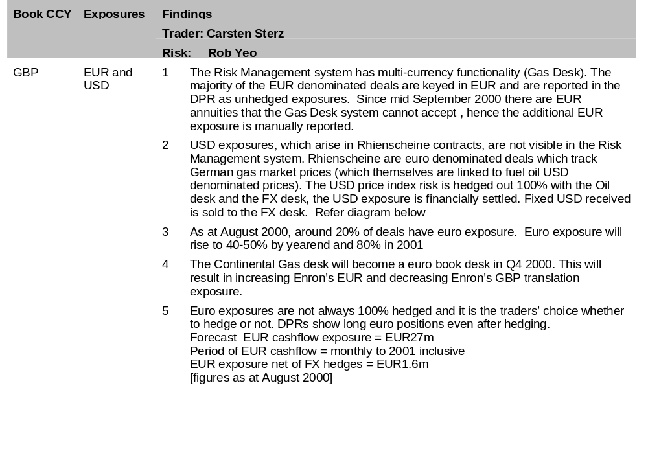
Continental Gas

Slide 38
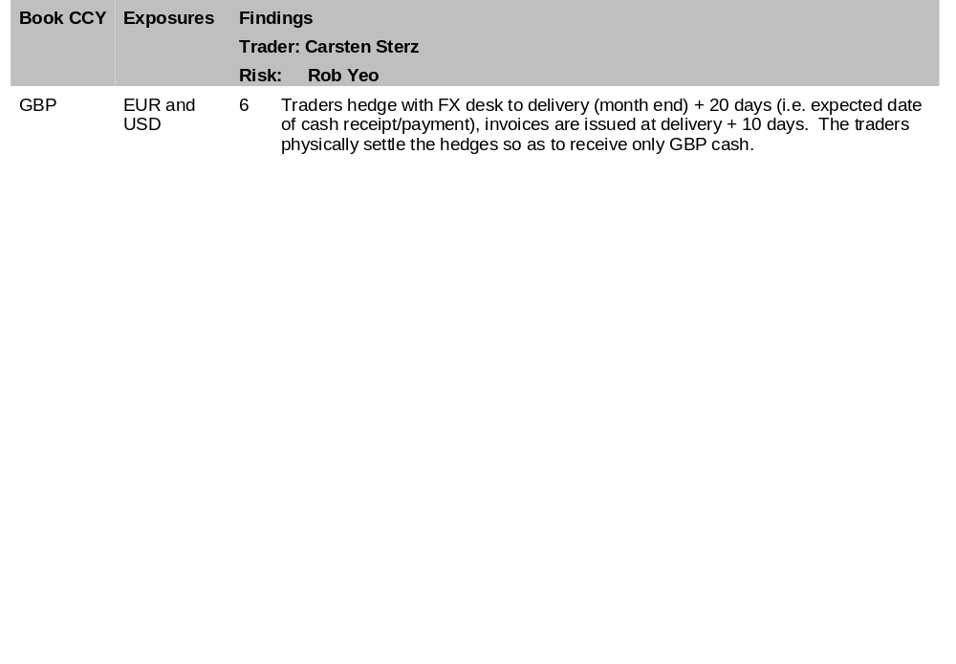
Continental Gas

Slide 39
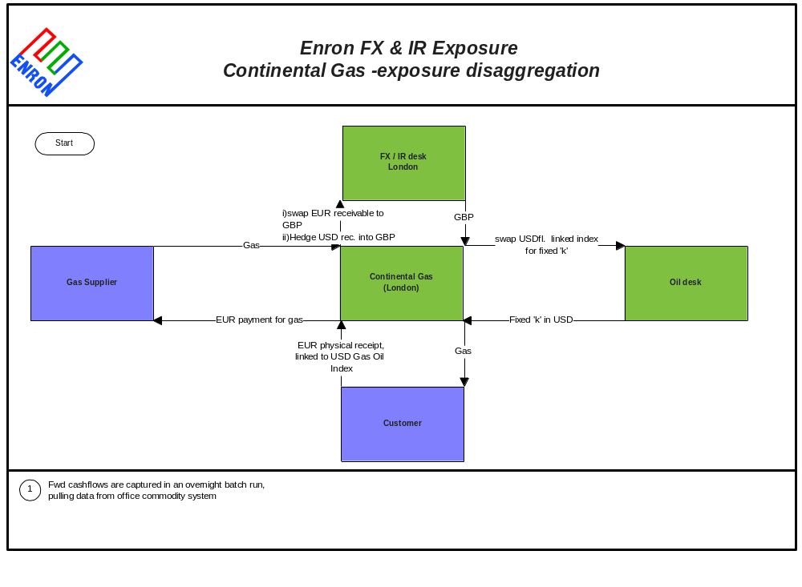
Continental Gas - inherent FX risk

Slide 40
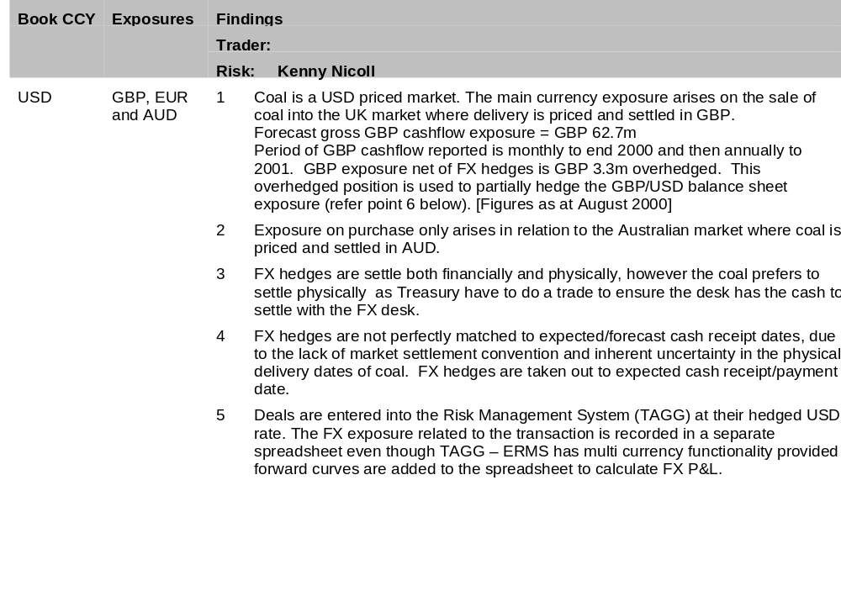
Coal

Slide 41
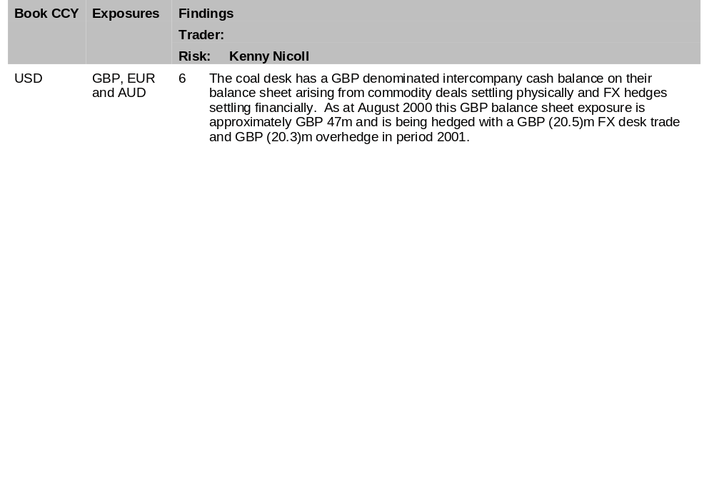
Coal

Slide 42
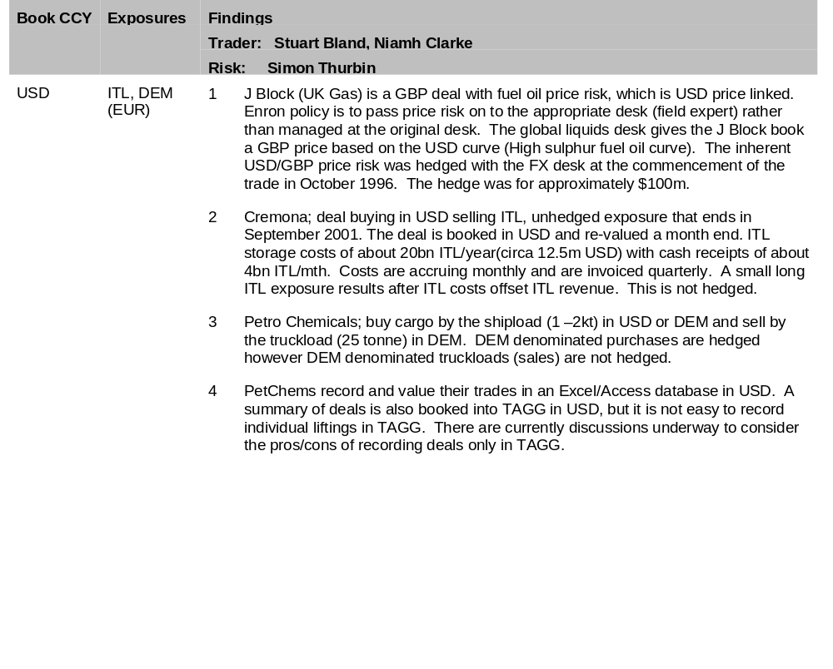
Liquids

Slide 43
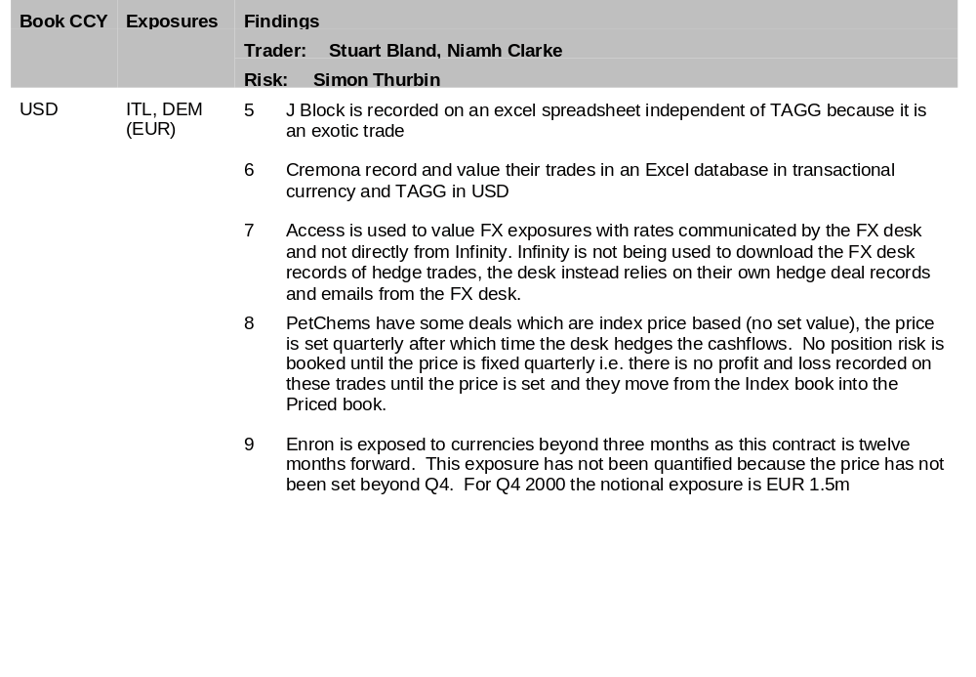
Liquids

Slide 44
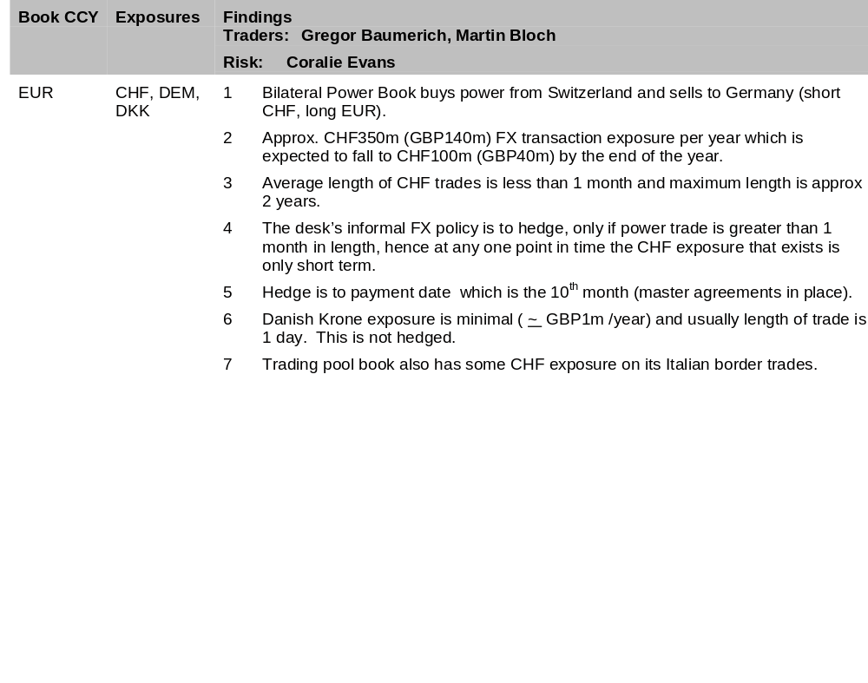
Continental Power

